Slide 1
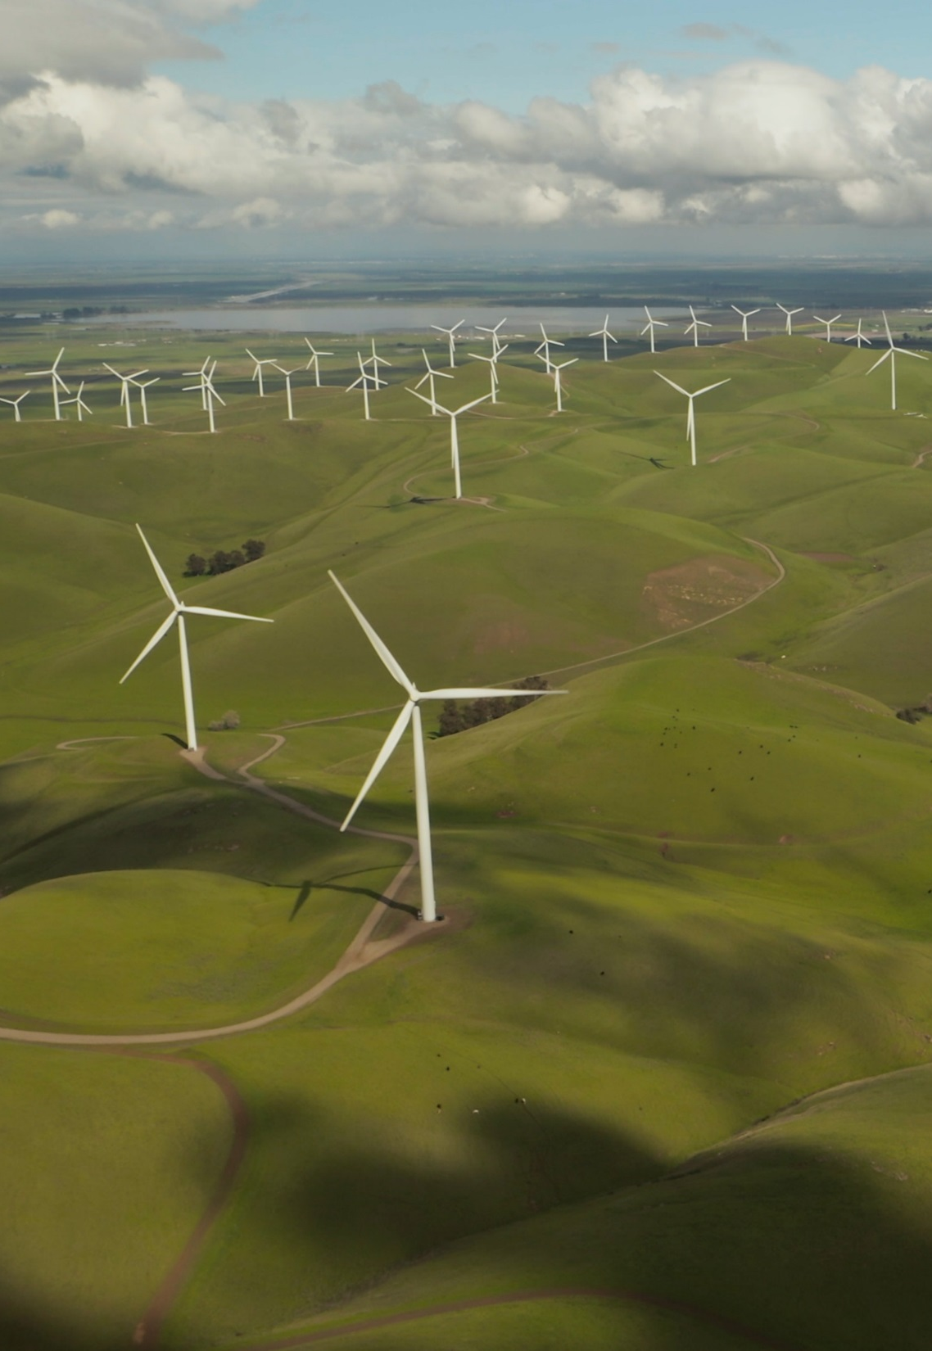


Scaling up financing for development, climate and nature
Implications for MIGA
Amar Bhattacharya
MIGA Presentation
February 8, 2023
Photo by Tyler Casey on Unplash

Slide 2
A critical moment in time
Members of the Independent High-Level Expert Group on Climate Finance
A moment of great risk and great opportunity. One path leads to attractive growth and development, the other to great difficulties and indeed destruction.
Even before the COVID-19 pandemic, emerging markets and developing countries (EMDCs) were facing challenges. As a result of the Covid pandemic and the war in Ukraine, EMDCs are under great pressure.
The present trajectory is one of slow growth, low investment and public spending, and rising debt service burdens in many, if not most, EMDCs. Risk of a lost decade for development.
We are off track on virtually all SDGs and ill prepared for the major demographic transitions ahead.
At the same time the urgency and opportunity of tackling climate change is becoming ever clearer.
Equally urgent challenge to protect and restore nature.
Acting on climate and nature is not a cost but rather an opportunity to unlock new and better forms of growth.
A major push on investment and innovation can drive a sustainable recovery and make a breakthrough on both development goals and climate.
Seizing that opportunity will require a clear strategic direction, strong and purposive policies, a massive scaling up and shift in investment and the mobilisation of the right finance at the right scale.

Slide 3
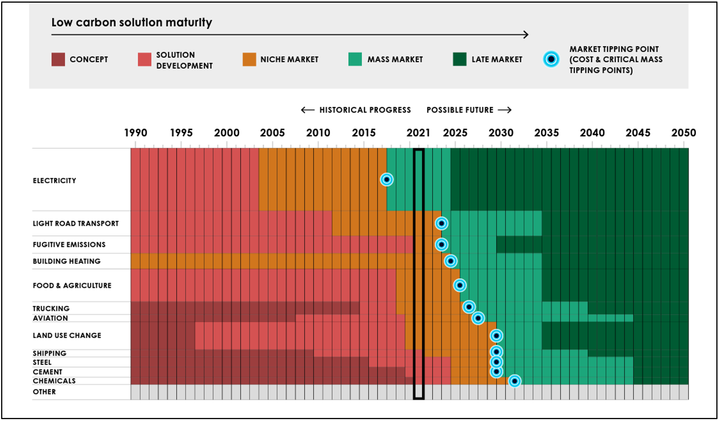
Tipping points for green transformation by sector
Historical progress and indicative future timeline
Notes:
The financing needs are esti
year 2030 and as such do not
ments for 0.
Source: Stern et al. (2023)

Slide 4
Investment must scale up by several points of GDP
Investment/spending needs per year for sustainable development and climate action for EMDCs (other than China):
Estimate | 2019 % GDP | 2030 % GDP | Gap (2030 minus 2019)¹ US$ billion | Gap (2030 minus 2019)¹ % GDP
SDG-related investment² | 11.3% | 18,2% | 3,500 | 6.9%
Of which climate and related investments³ | 2.1% | 6.9% | 1,800 | 4.8%
Notes:
Gap is defined as difference between estimated investment needs in 2030 and current baseline of investment in 2019.
Human capital, sustainable infrastructure (including on the energy transition), adaptation and resilience, AFOLU.
Energy transition, adaptation and resilience, AFOLU.
Source: Bhattacharya et al. (2022)
The growth and structural change agendas in EMDCs will already entail substantial energy investment. Savings from avoided investments in fossil fuels in EMDCs dwarf additional climate investment needs.
Investment requirements in natural capital, adaptation and resilience, and spending on loss and damage will be additional.

Slide 5



Investment and spending priorities for climate action and sustainable development
Members of the Independent High-Level Expert Group on Climate Finance
While the investment push is needed across the full spectrum of the sustainable development goals, the key investment and spending priorities to ramp up climate action and deliver on the related sustainable development goals are:
  Transformation of energy systems: major and rapid scale up of renewable energy; complementary public infrastructure; energy efficiency and transformation of demand; just transitions; curb methane emissions.
  Respond to the growing vulnerability of developing countries to climate change: both more frequent and damaging extreme events and the effects of “slow onset” especially on heat, precipitation and water. This will mean much better mechanisms to deal with loss and damage as well as greatly accelerating the investments in adaptation and resilience.
  Investing in sustainable agriculture and natural capital, which will be key to mitigation, adaptation and development. We must also ensure that we begin to restore right away the damage that we have done to our natural capital in terms of degraded land, deforestation, and damage to our water supply and oceans.
The climate and the biodiversity crises are deeply intertwined: they share common drivers, and each global challenge can worsen the other. As such, they must be addressed together.

Slide 6
Translating investment opportunities to reality:
unlocking ambitious investment programmes
Members of the Independent High-Level Expert Group on Climate Finance
Investments to ramp up climate action, for both mitigation and adaptation, will remain academic, unless countries are able to develop and implement investment programmes in a purposeful way.
These programmes need to be translated into concrete pipelines of projects and supported by a favorable investment climate. Investment depends on expectations, and clarity and credibility over the medium term are crucial.
Countries will need therefore strong and sustained policy and institutional reforms to unlock the scale and quality of investments and mobilise the domestic resources that will be needed. A concerted push will be needed on capacity building.
Country/sector platforms, driven by countries, help bring together key stakeholders around a purposeful strategy, scaling up of investments, tackling binding constraints, ensuring a just transition and mobilization of finance especially private finance.
It will also be important to make market mechanisms work more effectively and efficiently to direct capital where needed.

Slide 7




A new approach to finance: scale, urgency and options
Members of the Independent High-Level Expert Group on Climate Finance
The scale of the investments needed in EMDCs over the next five years and beyond will require a debt and financing strategy that:
  tackles festering debt difficulties, especially those of poor and vulnerable countries.
  leads to a major expansion and revamp of both domestic and international finance, public and private.
An overall financing strategy must utilize the complementary strengths of different pools of finance to ensure the right scale and kind of finance and to reduce the cost of capital rather than simply focusing on the aggregate number.
  It must embody a holistic and comprehensive approach to climate finance.
  It must align all finance with sustainability, including climate goals, in line with Article 2.1c.
  It must create the necessary partnerships to deliver concrete results.

Slide 8
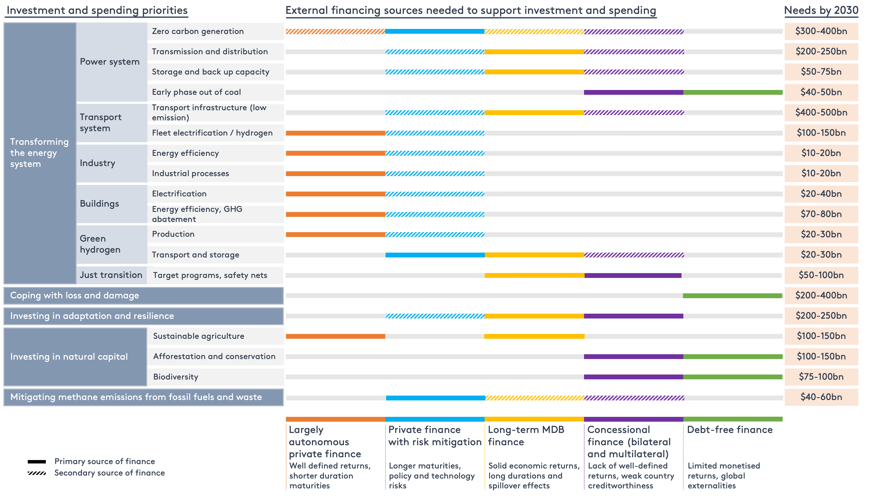
An additional $1 trillion per year is needed in external finance from different sources
External financing sources for investment and spending priorities for climate action and related development goals
Notes:
The categories of investment and spending necessary to meet climate and development goals are shown on the left-hand side. For each, we outline the mix of financing needed from external sources to support the related investment and spending priorities.
We distinguish between sources that would constitute the primary source of financing for one sector, and those that would play a secondary role.
On the right-hand side we outline the estimated investment and spending requirements by 2030 for each category.
Source: Songwe et al. (2022)

Slide 9
Addressing the debt challenge
Average developing county debt projections from 2019 to 2040
Source: Songwe et al. (2022)
A big push strategy is feasible only if the incremental financing comes largely on terms that are affordable, comparable to IBRD rates of interest.

Slide 10
Mobilizing private finance at scale
Members of the Independent High-Level Expert Group on Climate Finance
A growing proportion of investments can now be undertaken by the private sector. However, the mobilization of private finance today is far too low and will have to increase many times over.
Several private-sector led initiatives have been launched over the past two years. MDBs have also come forward with important new initiatives to catalyze private finance.
Private and public sectors need to work together to unlock investment opportunities, reduce, manage and share risk, and bring down the cost of capital. Promising de-risking tools to facilitate the translation of financial assets into financial flows for a strengthened response to climate change.
Need to develop concrete and standardized approaches that can unlock institutional capital at scale.
Sustainable finance agenda to help expand and improve the alignment of climate finance.

Slide 11
The cost of capital must be tackled
Developing country 10-year bond yields
Return expectation from solar projects in EMDCs
Country | S&P Rating | Required return from solar project (%)
Germany | AAA | 7%
USA | AA+ | 9%
UAE | AA | 10%
Saudi Arabia | A- | 12%
Chile | A | 12%
Morocco | BBB- | 15%
India | BBB- | 17%
Algeria | B | 18%
Oman | BB- | 18%
Peru | BBB | 20%
Costa Rica | B | 21%
Namibia | BB- | 21%
Ghana | B- | 22%
Brazil | BB- | 22%
Nigeria | B+ | 22%
Bolivia | B+ | 24%
Tanzania | B | 24%
Egypt | B | 28%
Zambia | CCC- | 38%
Argentina | CCC+ | 52%
Source: Trading Economics and World Government Bonds, Market Insider, and Haver Analytics
Source: CPI, forthcoming

Slide 12
MDBs are central to the expansion of investment in climate and development action in EMDCs
Members of the Independent High-Level Expert Group on Climate Finance
Considering the scale and urgency of current climate and development challenges, MDBs and the development finance system as a whole will need to significantly increase their activities.
  Working as a system, the MDBs should engage with countries and the private sector to play a purposive and proactive role in helping countries define, identify, enable and foster the investments and programmes necessary.
  MDBs have a critical role to play in catalysing private finance and in supporting the large necessary public investments.
  The MDBs and their shareholders must explicitly recognise that these tasks require a multiplying of their flows of finance by a factor of three in the next five years.
  This scaling up of financial flows from the MDBs can be built in part on more effective utilisation of the capital already available.
  Shareholders must recognise that substantial capital increases for the MDBs over the coming five years will be required to achieve the necessary three-fold increase in flows.
  Beyond the MDBs, there is great potential to harness the entire public development bank system.

Slide 13
Development banks can play a key role to moving from “billions” to “trillions” to finance a big push investment strategy
Capital
Annual Lending
700 - 1000
400 - 800
35 - 50
70
680
70
70
Current Equity Capital
Additional Paid-In Capital (one time)
Additional Callable Capital
(20x)
Current
Annual Lending
Increase Incremental Lending
(2x)
Adjust Gearing Ratio
(1.5x)
Private Sector Leverage
(2x - 4x)
The MDBs have a crucial role to play in helping reduce government-induced risk through the use of their instruments (global equity, long-term loans, and guarantees), thereby reducing the cost of capital. They also bring trust and convening power in supporting projects and platforms.
Need better utilization of capital, more capital, and higher private sector multipliers to deliver necessary scale of finance.

Slide 14
Scaling up concessional finance is critical
Members of the Independent High-Level Expert Group on Climate Finance
Donors must:
  double bilateral climate finance to $60 billion by 2025 from its 2020 level.
  rapidly scale up their commitment to adaptation finance in line with the Delivery Plan.
  enhance their support to the multilateral concessional climate-related funds.
  Improve effectiveness and alignment with country priorities, access and transparency
Expand the envelope of low-cost finance:
  Augment the use of special drawing rights (SDRs) for climate finance by bolstering further the Resilience and Sustainability Trust; modernize the architecture for rechanneling SDRs; augment the pool of SDRs through regular issuance; expand channels for use including MDBs; and leverage SDRs to catalyze private finance.
  Tap voluntary and compliance carbon markets for priorities such as restoration of forests, peatlands and degraded land and the accelerated phase-out of coal.
  Create an International Financing Facility like mechanisms for climate and nature.
  Leverage the growing flows of private philanthropy

Slide 15
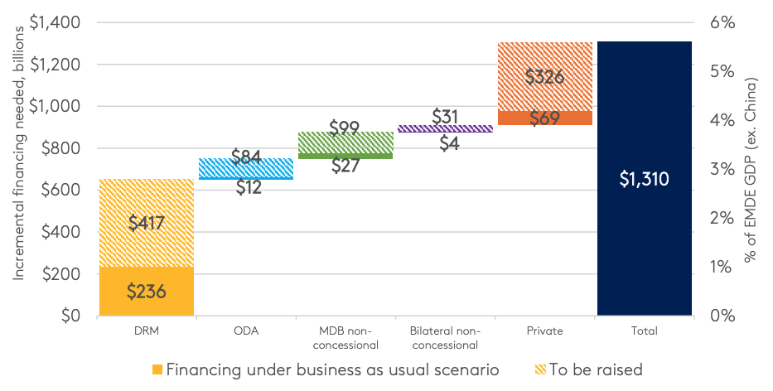
A “Grand Match” to deliver on scale of finance needed
Grand-match financing strategy – incremental finance needed between 2019 and 2025 (billions 2019 US$)
Source: Bhattacharya et al. (2022)
A sustained effort to boost financing from all sources must start now given the urgency of the climate challenge.

Slide 16
Conclusion
Members of the Independent High-Level Expert Group on Climate Finance
We are at a critical moment for the future of people and planet.
A big push on investment for development, climate and nature, together with innovation and a sharp focus on sustainability in all its dimensions, can drive a sustainable recovery from the present crisis, restore momentum on development and poverty reduction, and is the ONLY way to keep climate goals in reach.
We have in our reach a much more attractive form of growth—more sustainable, inclusive and resilient.
Such a big push will be challenging but feasible. Delay is deeply dangerous.
Domestic leadership and action on policies and resource mobilization will be foundational to such a scaled-up effort.
But will need to mobilize substantial external resources and support given the scale and urgency of the challenge. Three main pillars of such finance:
  A major revamp of the MDB and broader DFI system.
  Creating a new highway for private finance.
  Mobilizing the necessary scale of concessional financing through sustained commitment of donors and expanding the envelope through innovative options.
Cooperation and coordination on this big push can be accelerated through country/sector, regional and global platforms with buy-in of all stakeholders.

Slide 17
Implications for MIGA
Members of the Independent High-Level Expert Group on Climate Finance
The role of private investment and finance is critical for a successful green transformation.
The scale of this investment opportunity is immense but the nature of the investments different from the past.
To unleash these investments, must tackle impediments to investment and the high cost of capital.
A sound approach to derisking from end-to-end is the only way to unlock private finance at scale.
MIGA is well suited to mitigating some critical risks, but not ALL of the risks.
MIGA will need to move from a transaction to a system approach within the framework of country-led energy transition and infrastructure development strategies.
Country platforms can play an important coordinating role.
Where these are not fully articulated, MDBs will need to work with governments, the MDBs and the private sector.
MIGA should engage more systematically with the private sector on possible derisking instruments and platforms.
If MIGA does not step into this role, the international community will look to other structures and mechanisms.

